Slide 1

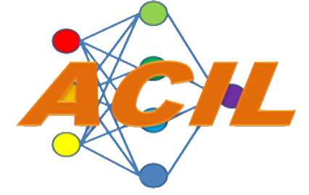
ACIL – DAC Final Report
1 October 2022 – 30 September 2024
Dr. Donald C. Wunsch II
Dr. Daniel Shank
Dr. Mario Aguilar (Teledyne)
Dr. Jian Liu
Dr. Tao Wu
Dr. Sasha Petrenko
Blin Richard
Iwan Sandjaja
Yuwei Long
Shane Cairns
Jiali Zhang
Avery Raulston
Thomas White
Thomas Strohmeier

Slide 2
Administrative
Cooperative Agreement # | W911NF-22-2-0209
Project Title: | AI-Enhanced Infrared Analysis for Lethality, Survivability, Effectiveness and Integrated Performance
Principal Investigator: | Dr. Donald C. Wunsch II
Co-Investigator(s): | Dr. Daniel Shank
Period of Report: | 1 October 2022 – 30 September 2024

Slide 3
Overview
Technical Status Progress
Brief review
Milestones met
Milestones unmet
Technical issues
Major developments
Business Status Report
Summarized C.A. resources
Status of resources
Compare resource status
Major deviations

Slide 4

Technical Status Progress

Slide 5
Technical Summary
Technical Status Progress
Brief review
Milestones met
Major developments

Slide 6
Milestones/Objectives
3.2.1 Unification of offline-learned feature extractors with ART-based, online-capable L2M(Lifelong Machine Learning) system.
3.2.2 Edge-capable design of L2M system for passive IR analysis.
3.2.3 Collaboration and dissemination of results with ARL, the NVESD, the CISD, and Teledyne/FLIR.

Slide 7
Completed Work
Number | Milestone Description | Objective | Status
Milestone 1.1 | Clustering Algorithms and Long-Life Learning for Hybrid L2M System. | 3.2.1 | Completed
Milestone 1.2 | Hardware Integration, Data Collection, and Super-Resolution for Hybrid L2M System. | 3.2.1 | Completed
Milestone 2.1 | Optimization of the L2M System for Edge Computing Platforms with AI Trust Enhancements. | 3.2.2 | Completed
Milestone 2.2 | Real-Time Object Recognition using YOLO and ART-Based Learning for IR Analysis. | 3.2.2 | Completed
Milestone 2.3 | UAV Data Collection Path Planning under Battery Energy Constraints. | 3.2.2 | Completed
Milestone 3.1 | Collaboration with Teledyne-FLIR on Hardware Provision and Integration. | 3.2.3 | Completed
Milestone 3.2 | Collaboration with Teledyne-FLIR on Academic Research, Joint Publications, and Technology Transfer. | 3.2.3 | Completed

Slide 8
Objective 3.2.1 Achievement
Clustering & Lifelong Learning:
Developed iCVI-TopoARTMAP and TopoBARTMAP.
Enhanced incremental and adaptive learning capabilities.
Open Software
YOLOv10 Integration:
Combined Simple ARTMAP with YOLOv10.
Enabled adaptive object classification without extensive retraining.
Hardware & Data Collection:
Implemented 3D-printed camera modules on Aurelia X4 drones.
Utilized FLIR Hadron cameras for data acquisition.
Super Resolution

Slide 9
Objective 3.2.2 Achievement
Real-Time Object Recognition:
Implemented YOLOv8 to YOLO V11 for IR data analysis.
Improved accuracy and deployment efficiency.
Demo
UAV Path Planning:
Developed reinforcement learning algorithms for drone routes.
Optimized operations under battery constraints.
AI Trustworthiness:
Created metrics for measuring trust in L2M systems.
Incorporated AI trust enhancements for reliable operation.

Slide 10
Objective 3.2.3 Achievement
Collaboration with Teledyne-FLIR:
Established partnerships for hardware provision and technology transfer.
Gained practical insights and accelerated system deployment.
Human Resource Development:
Team members obtained UAS Remote Pilot Certifications.
Enhanced capabilities in drone operations and AI development.

Slide 11
Camera+Drone
A Step Towards Data Collection and Super Resolution
Presenter: Iwan Sandjaja

Slide 12
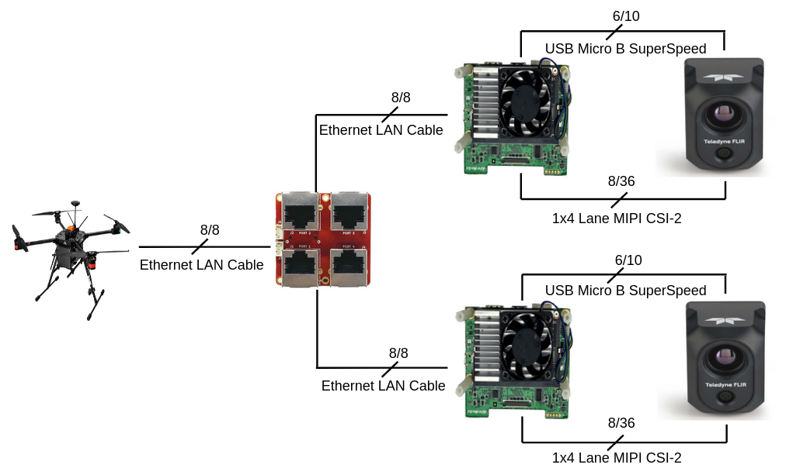
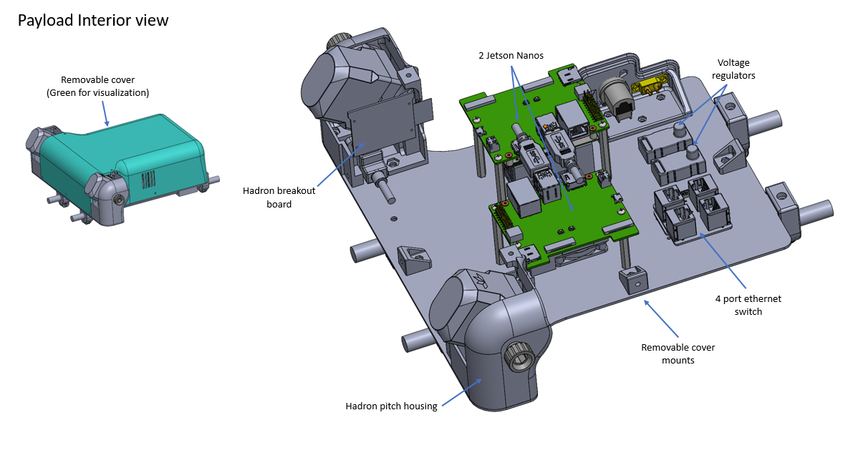
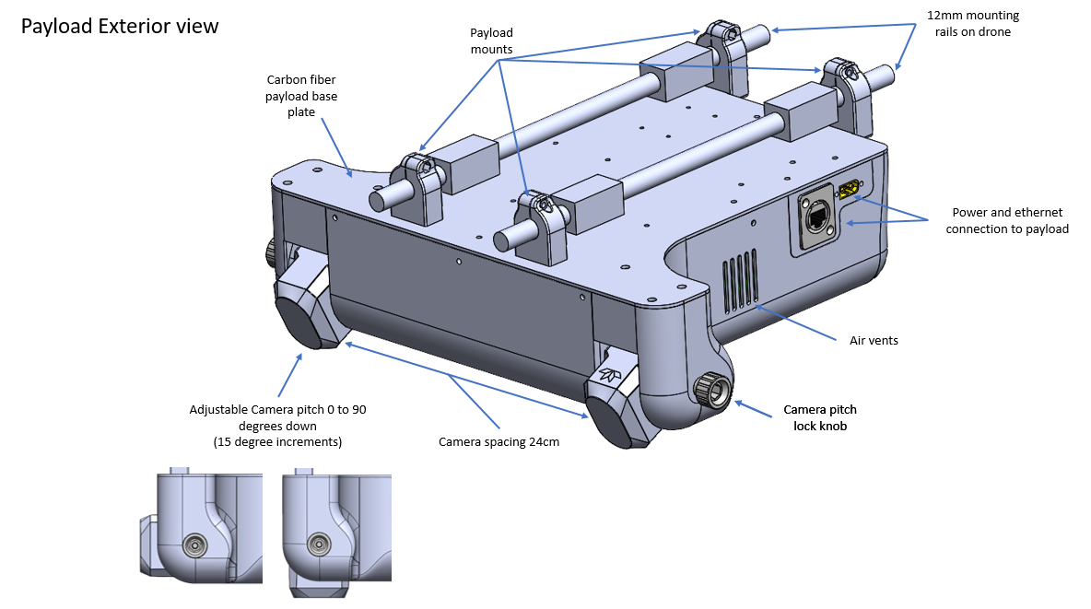
Hadron Camera Payload Module
The implementation of previous quarter design
Notes:
Thermal Image Super-Resolution Challenge – CVPR 2023
-The use the of the camera
-Specification of the board
-Data collection
-Pin Mapping
-Demo with Windows

Slide 13
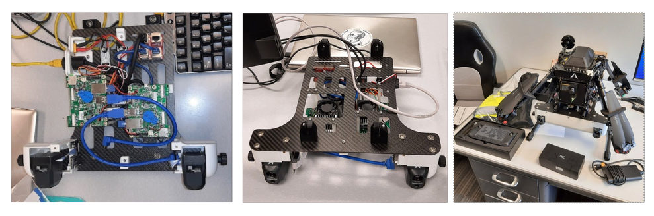
Aurelia X4 Standard with the Camera Payload Module

Slide 14
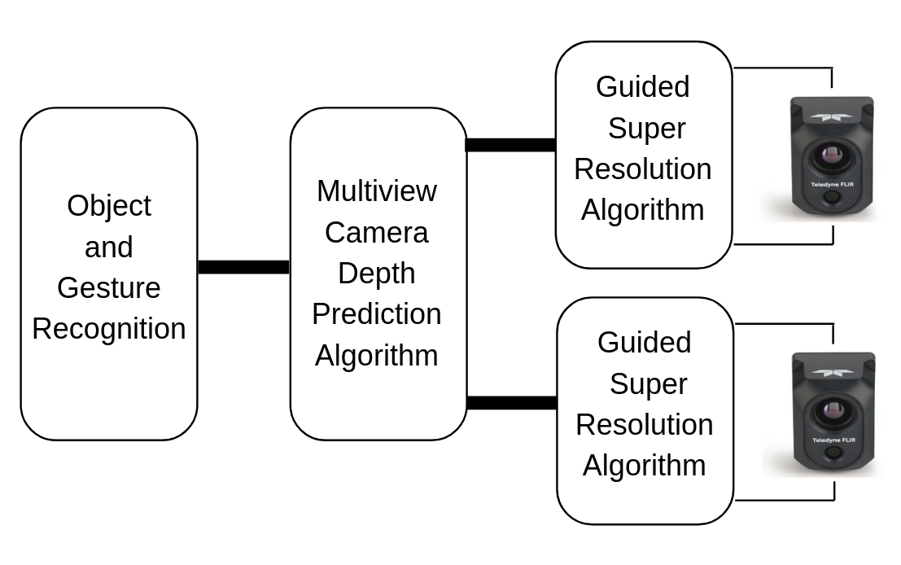
Binocular Vision Block Diagram

Slide 15
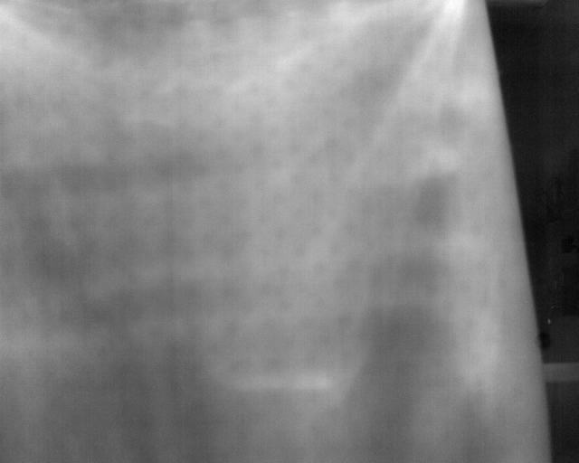
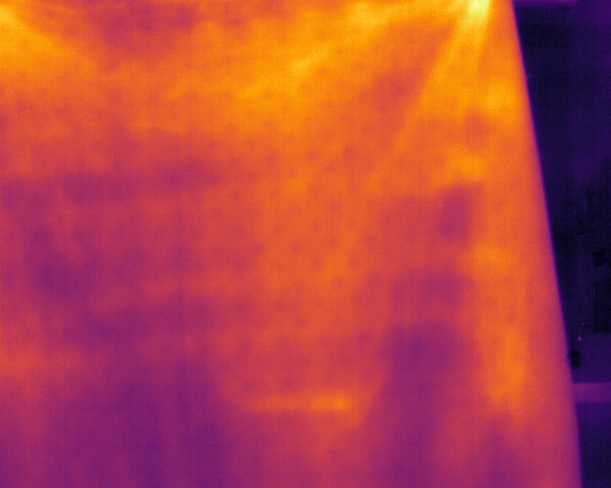
Guided Super Resolution Algorithm

Slide 16
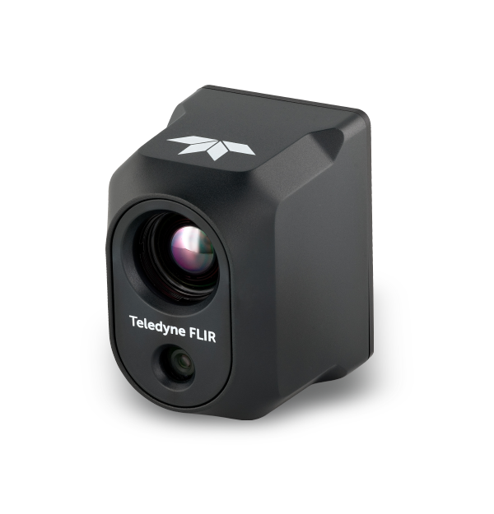
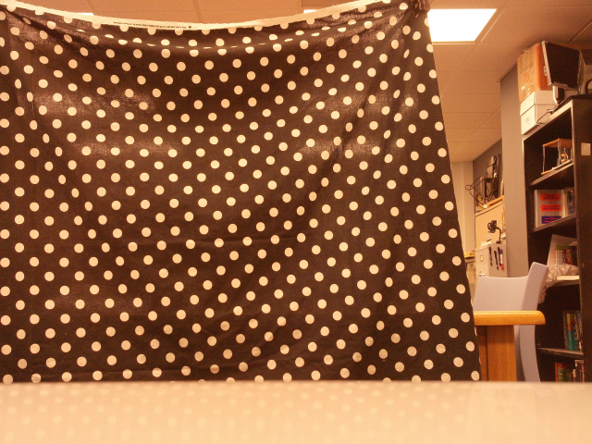
Guided Super Resolution Algorithm
VGA (640x512)
1 channel 16 bits
± 345 kB
20MP (5248x3936)
3 channels RGB 8 bits
± 37 MB

Slide 17
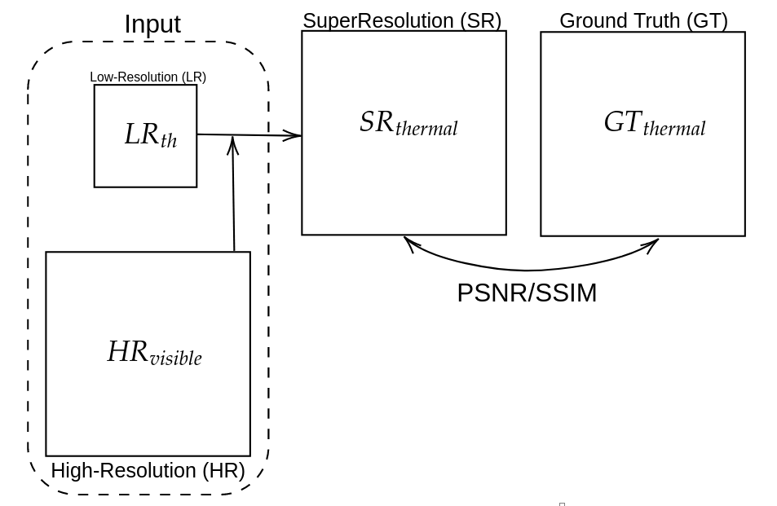
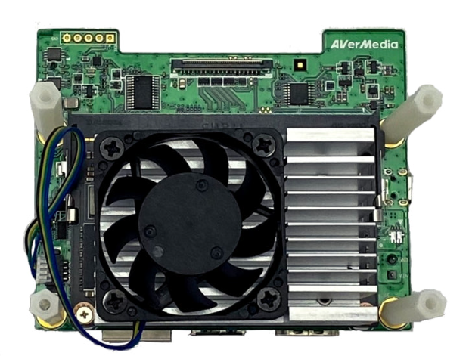
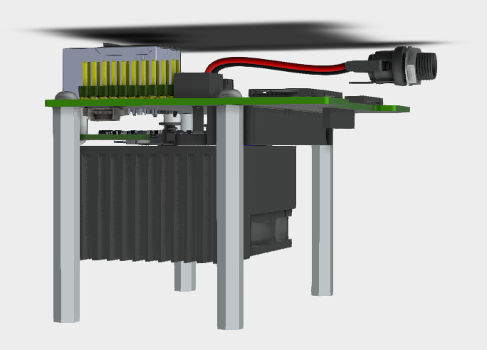
The Guided Super Resolution Algorithm

Slide 18
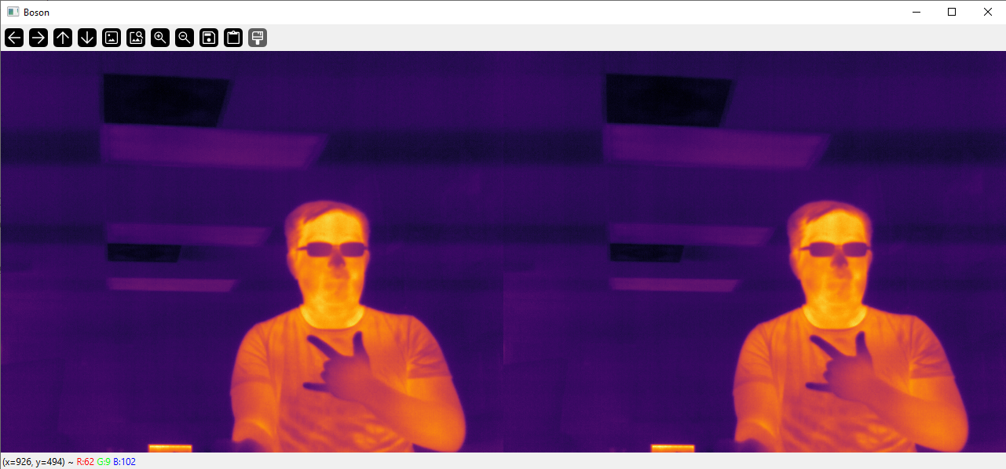
Binocular Depth Prediction Algorithm

Slide 19
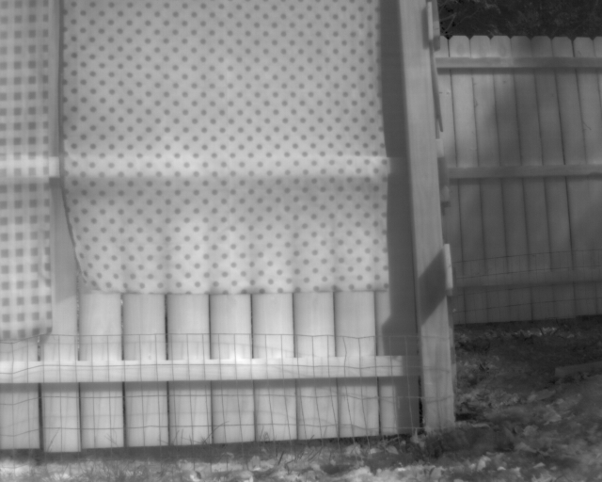

Binocular Depth Prediction Algorithm

Slide 20
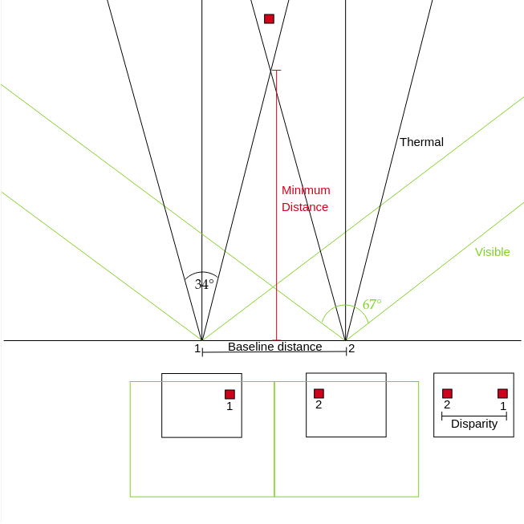
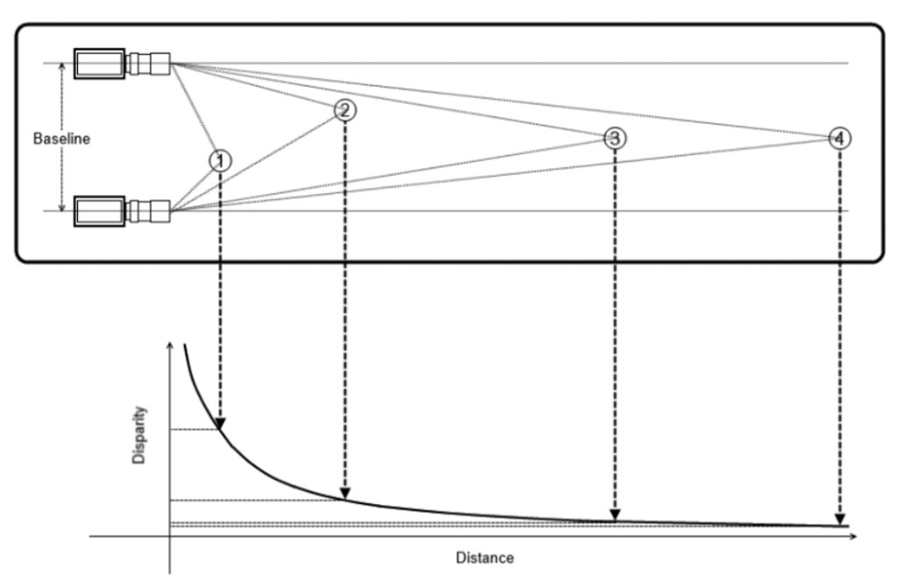
25 cm Baseline Distance

Slide 21
YOLO + ART
A Step Towards Lifelong Object Detection
Presenter: Shane Cairns

Slide 22
YOLO Review
YOLO (You Only Look Once) Object Detection
Takes an image and splits it into a grid
Each grid cell predicts bounding boxes and class probabilities
All predictions are processed end-to-end in one pass

Slide 23
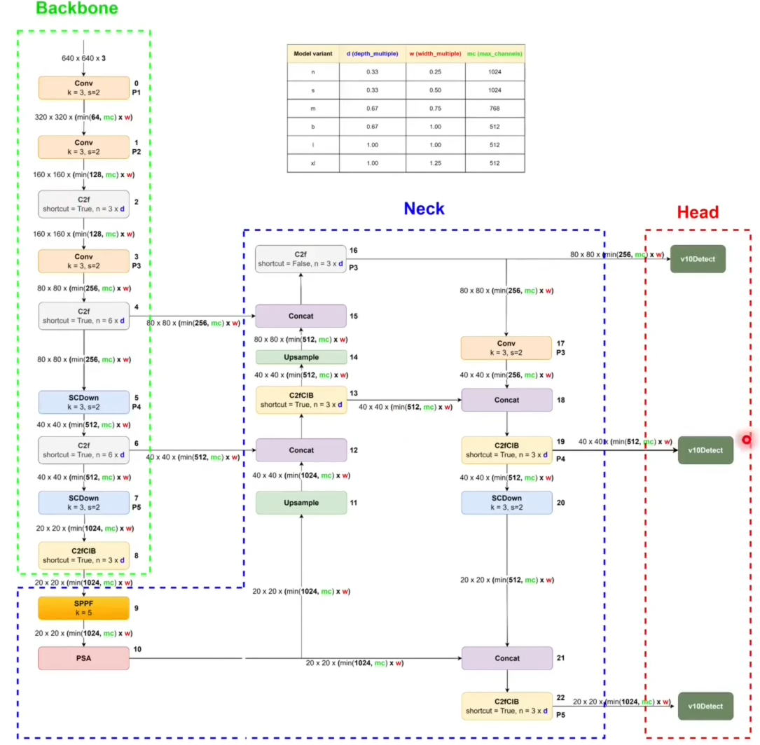
YOLOv10
Architecture

Slide 24
YOLO Struggles
YOLO (You Only Look Once) Object Detection
Fixed Architecture: Trained once and not easily updated with new classes
Catastrophic Forgetting: When retrained with new data, older classes can degrade in accuracy
Limited Adaptability: Not designed to grow or modify its representations on-the-fly

Slide 25
ART in Object Detection
ART: a family of neural networks that learn incrementally without forgetting previous knowledge
Dynamically creates new feature categories for novel inputs
Maintains stable representations of learned classes
Provides a framework for ongoing, lifelong learning

Slide 26
YOLO + ART
Combined Approach: Use YOLO’s efficient detection pipeline to extract features and feed them into ART
Unsupervised Category Formation: ART clusters unfamiliar feature patterns into new categories on-the-fly
Seamless Class Expansion: When provided with a label, these new categories become new classes without retraining from scratch

Slide 27
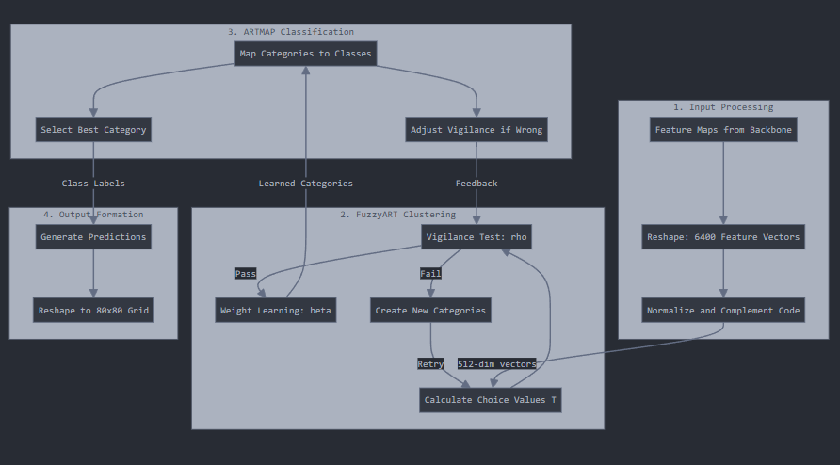
1. Input Processing
Feature Extraction: Takes feature maps from the YOLO backbone (e.g., CNN outputs)
Reshape & Preprocess: Converts feature maps into a set of normalized 512-dimensional vectors

Slide 28
2. FuzzyART Clustering
Vigilance Check (ρ): Compares incoming feature vectors to learned categories
Category Creation: If no existing category fits a new one is formed
Weight Updates: If it fits an existing category that category’s weights are updated, ensuring stable, incremental learning of feature patterns

Slide 29
3. ARTMAP Classification
Category-to-Class Mapping: Links each FuzzyART category to a specific object class label
Feedback Adjustment: If the predicted class is incorrect, vigilance or category boundaries are refined.

Slide 30
4. Output Formation
Prediction Grid: Results are integrated back into a spatial grid format (e.g., 80x80) to generate final object detection outputs—bounding boxes, confidence scores, and class labels.

Slide 31
Thank you
We appreciate your time and interest in our work.
Code Repository: https://github.com/syre-ai/yolov10demo
Live Demo: https://yolov10demo.live/

Slide 32
Benefits of YOLO + ART
Lifelong Learning: Continual adaptation as new object types are encountered
Stability + Plasticity: Maintains old knowledge while integrating new classes
Easier Class Addition: Adding new object classes is simplified; just provide a label for a newly formed category—no full retraining needed
Broad Applicability: Suitable for environments where new objects regularly appear (e.g., robotics, surveillance, autonomous systems)

Slide 33
YOLO-Based Object Detection: Insights and Innovations
Presenter: Jiali Zhang
Thomas White
Malacki Ehlers
Notes:
Good morning, everyone.
Today, I’m excited to share our work on “YOLO-based object detection”.
This work collaborate with Thomas and Malaki.
Before diving into our new findings, let’s briefly review our earlier custom models.

Slide 34
YOLO Model Updates
Recall for Previous Model:
Number of Classes:
This model detects 4 categories: People, Bicycles, Cars, and Dogs.
Model performance:
Model | Class | Instances | Precision | Recall | mAP50 | mAP50-95
YOLO V10 | Person | 5778 | 0.855 | 0.62 | 0.78 | 0.389
YOLO V10 | Bicycle | 470 | 0.655 | 0.449 | 0.51 | 0.193
YOLO V10 | Car | 5431 | 0.844 | 0.809 | 0.881 | 0.583
YOLO V10 | Dogs | 14 | 0.584 | 0.0714 | 0.0752 | 0.0376
YOLO V10 | All | 11693 | 0.735 | 0.487 | 0.562 | 0.301
Notes:
Previously, we trained a custom YOLOv10 model to detect four categories: People, Bicycles, Cars, and Dogs.
As seen here, it achieved a strong overall precision of 0.735.
These results were promising and motivated us to explore further.
However, these initial outcomes also raised new questions.

Slide 35
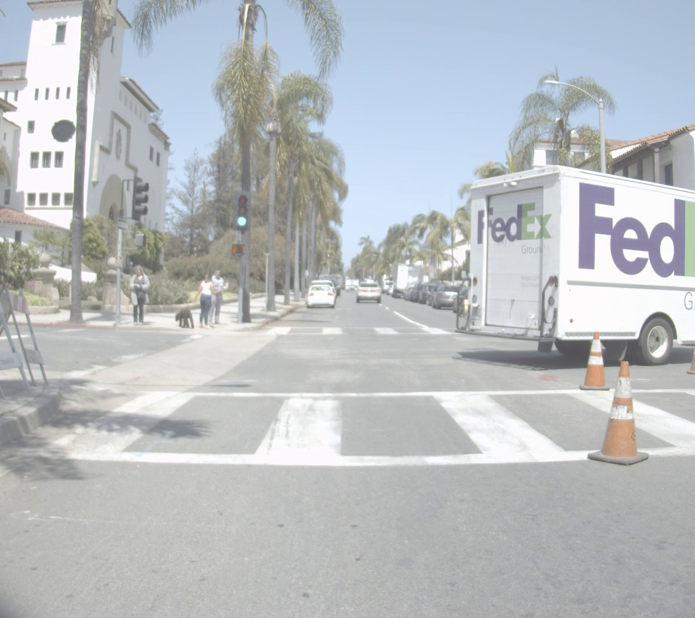
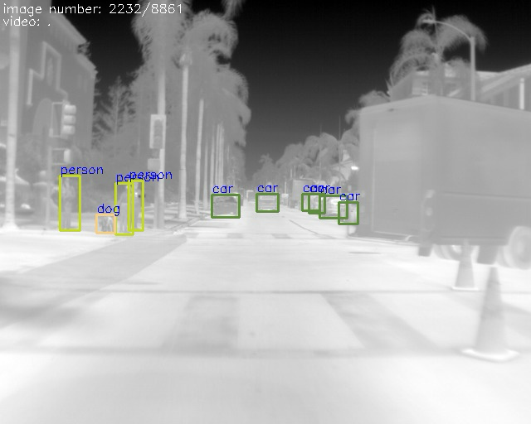
Next Steps & Questions
Example of a scenario where the model fails to detect the ‘FedEx’ truck.
Can we fix the problem that the model cannot detect the “FedEx” truck?
Are there more effective baseline models than YOLO v10 for our dataset?
What techniques can we use to improve detection of predominantly small objects?
RBG_02233.jpg
Thermal_02233.jpeg
Notes:
From these results, we asked ourselves three key questions:
First, how can we address the scenario where the model fails to detect certain objects, such as the “FedEx” truck shown here? This issue was also brought up by our sponsor in the last quarterly meeting.
Second, are there more effective baseline models for our specific dataset than YOLOv10?
Finally, what methods can we use to improve detection of smaller objects?
These questions shaped the direction of our subsequent research and also roadmap for the rest of my presentation.

Slide 36
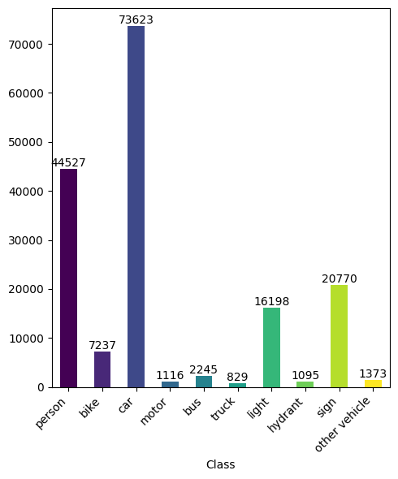
Dataset and Class Distribution (Answer 1)
Dataset: Teledyne FLIR ADAS v2
Classes: The dataset includes 10 categories: Person, Bike, Car, Motor, Bus, Truck, Light, Hydrant, Sign, and Other Vehicle.
Class Frequency: The bar chart shows the number of instances per category, indicating strong representation across multiple object types.
Notes:
To answer the first question, we explored a more comprehensive dataset.
We used the FLIR ADAS v2 dataset, which includes 10 categories: Person, Bike, Car, Motor, Bus, Truck, Light, Hydrant, Sign, and Other Vehicle.
The bar chart on the right shows class frequency, the distribution of classes was uneven:
some classes like “person”“Car”have a lot instances, which is really good for our training.
while other classes like “Motor” or “Truck” are less frequent, which might impact performance.
Understanding these distributions is critical since model accuracy often related to the frequency of each class during training.
Next, we needed to find the strongest baseline model.

Slide 37
Testing Multiple YOLO Versions (Answer 2)
Approach: To find a stronger baseline, we trained five YOLO variants (v5n, v8n, v9n, v10n, v11n) on the new dataset under identical conditions.
Training Environment:
Cluster: Mill Cluster
GPUs: 2 × Tesla V100-SXM2 (32GB)
Framework: PyTorch, CUDA
Baseline | Epochs | Batch Size
YOLOv5n | 200 | 64
YOLOv8n | 200 | 64
YOLOv9n | 200 | 64
YOLOv10n | 200 | 64
YOLOv11n | 200 | 64
Notes:
It’s also our answer for the second question.
To identify a better baseline, we selected 5 models from yolo family: YOLOv5n, YOLOv8n, YOLOv9n, YOLOv10n, and YOLOv11n.
Each of these versions was trained under identical conditions
—same number of epochs 200, same batch size 64, on the same cluster with two Tesla V100 GPUs.
By holding training conditions constant, we could directly compare each versions capabilities and determine which version provides the strongest baseline moving forward.
Let’s see how they performed in the next slide.

Slide 38
Comparative Results of YOLO Variants
Precision: Accuracy of detections
Recall: Coverage of all ground truths.
mAP50: Mean Average Precision at IoU=0.50
mAP50-95: Mean Average Precision averaged over IoU=0.50 to 0.95
Model | Precision | Recall | mAP50 | mAP50-95
YOLOv5n | 0.61 | 0.41 | 0.47 | 0.28
YOLOv8n | 0.62 | 0.46 | 0.51 | 0.31
YOLOv9n | 0.62 | 0.41 | 0.46 | 0.27
YOLOv10n | 0.59 | 0.42 | 0.47 | 0.28
YOLOv11n | 0.62 | 0.41 | 0.46 | 0.27
Conclusion: YOLOv8n achieved the highest scores in all evaluation metrics, demonstrating superior overall performance.
Notes:
As shown in the table, yolov8 consistently achieved the highest scores across all evaluation metrics.
Although it’s not the newest version, YOLOv8 offered the best balance of accuracy and representation for our data.
This was a key finding, because it not only helped us choose a stronger baseline model but also indicates that YOLOv8’s architecture is particularly well-suited for thermal image and our tasks.
Let’s look at a few examples to see YOLOv8’s effectiveness in the next slide.

Slide 39
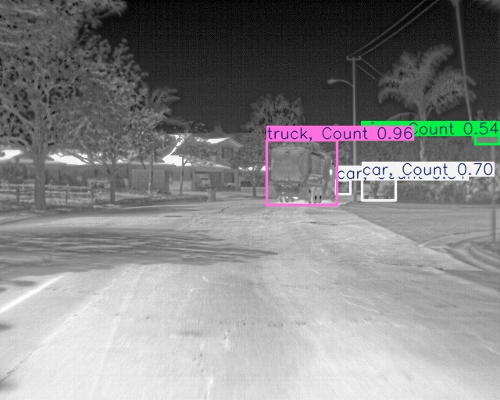
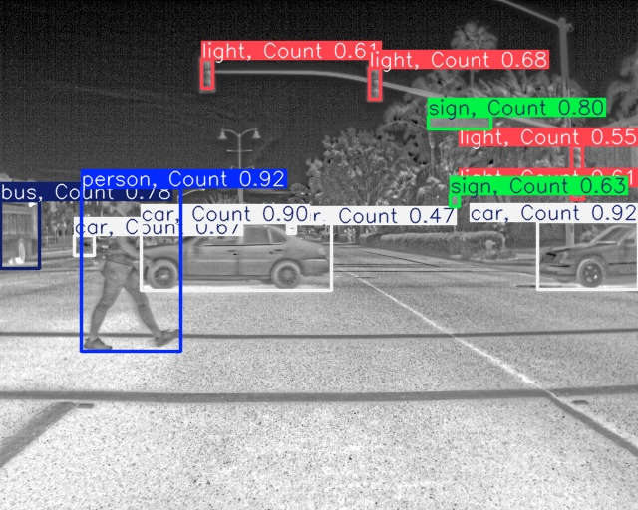
Detection Example
Picture 1
Picture 2
Notes:
Here are two detection examples.
On the left, we have a thermal image where the model correctly identifies multiple cars and especially a truck, which we cannot do in our last model.
On the right, our model accurately detects multiple classes, including people, cars, and traffic signs, traffic lights, even there are so many objects in one picture.
In the next slide, let’s take a close look at detailed performance of our model.

Slide 40
Class-Level Evaluation with YOLOv8
Detailed performance metrics per class
Evaluation results for our customized YOLOv8 model.
Class | Images | Instances | Precision | Recall | mAP50 | mAP50-95
All | 1144 | 16518 | 0.624 | 0.463 | 0.507 | 0.308
Person | 791 | 4309 | 0.76 | 0.676 | 0.749 | 0.429
Bike | 135 | 170 | 0.521 | 0.544 | 0.522 | 0.329
Car | 1047 | 7128 | 0.798 | 0.782 | 0.84 | 0.602
Motor | 47 | 55 | 0.756 | 0.62 | 0.727 | 0.392
Bus | 126 | 179 | 0.789 | 0.492 | 0.617 | 0.441
Truck | 42 | 46 | 0.224 | 0.283 | 0.138 | 0.087
Light | 439 | 2002 | 0.694 | 0.483 | 0.543 | 0.254
Hydrant | 93 | 94 | 0.659 | 0.226 | 0.335 | 0.19
Sign | 848 | 2472 | 0.66 | 0.461 | 0.507 | 0.311
Other Vehicle | 53 | 63 | 0.382 | 0.0635 | 0.096 | 0.041
Color Coding:
Green: Strong performance
Yellow: Lower performance with small instances
Bule: Strong performance with small instances
Notes:
Diving deeper, we performed class-level evaluation to see how well YOLOv8 did for each category.
Green-highlighted categories like “Person” and “Car” show strong performance, which is expected given they have a lot instances in the dataset.
In contrast, the yellow-highlighted classes “Truck” and “Other Vehicle” have lower precision (0.22 and 0.38, respectively). One reason is the limited number of samples for these categories. Another factor is that these classes share similarities with “Car,” making them harder for the model to distinguish.
Interestingly, if you look at the “Hydrant”category in Bule, we have low instances but high precision 0.65. That’s because it’s unique shape and features help the model recognize Hydrant more consistently, despite its lower frequency in the dataset.
To improve performance, especially for small objects and complex conditions, we explored new architectural elements in the next slide.

Slide 41
Evaluating Modified Architectures (Answer 3)
We integrated three architectural variants into YOLOv8 to potentially improve detection performance:
AFPN-YOLOv8: Incorporates an Asymptotic Feature Pyramid Network [1].
HGNet-YOLOv8: Based on real-time object detection improvements from HGNet [2].
MobileNetV4-YOLOv8: Combines the efficiency of MobileNetV4 with YOLOv8 [3].
Model​ | Precision​ | Recall​ | mAP50​ | mAP95​ | Flops (s)
AFPN-YOLOv8​ | 0.572​ | 0.403​ | 0.451​ | 0.267​ | 15.0
HGNET-YOLOv8​ | 0.553​ | 0.407​ | 0.431​ | 0.245​ | 30.8
MobileNetV4-YOLOv8​ | 0.528​ | 0.45​ | 0.454 ​ | 0.266 ​ | 6.7
YOLOv8​ | 0.624​ | 0.463​ | 0.507​ | 0.308​ | 6.8
FLOPs: Computational complexity (lower may indicate faster inference)
Takeaway: While these variants incorporated more advanced or efficient backbone, neck and head, the original YOLOv8 baseline still offers the best overall performance across all measured metrics.
Future work: Further tuning or combining architectural elements to surpass the baseline, particularly in challenging scenarios such as small object detection, and thermal images.
[1] Yang G, Lei J, Zhu Z, et al. AFPN: Asymptotic feature pyramid network for object detection[C]//2023 IEEE International Conference on Systems, Man, and Cybernetics (SMC). IEEE, 2023: 2184-2189.
[2] Zhao Y, Lv W, Xu S, et al. Detrs beat yolos on real-time object detection[C]//Proceedings of the IEEE/CVF Conference on Computer Vision and Pattern Recognition. 2024: 16965-16974.
[3] Qin D, Leichner C, Delakis M, et al. MobileNetV4: Universal Models for the Mobile Ecosystem[C]//European Conference on Computer Vision. Springer, Cham, 2025: 78-96.
Notes:
We integrated 3 architectural enhancements into YOLOv8:
AFPN (Asymptotic Feature Pyramid Network): A neck component aimed at improving small object detection.
HGNet: A detection head designed for more accurate bounding boxes, especially for small or partially obscured objects.
MobileNetV4-YOLOv8: A lightweight backbone intended to reduce computational load, because in the future, we want to deploy the model in the drone.
We hoped these modifications would boost performance. However, as shown in the table, the original YOLOv8 baseline still has the best overall results across all metrics. On the positive side, the FLOPs column shows that the MobileNetV4-based model is more computationally efficient, meaning it could run faster and be more suitable for real-time drone applications.
In the future, we plan to further fine-tune our models and explore new architectures that can better handle challenging scenarios, such as small object detection and thermal image.

Slide 42
Thank you
We appreciate your time and interest in our work.
Code Repository: https://github.com/JialiZhang1016/YOLOV10_Thermal
Live Demo: https://yolov10demo.live/
Notes:
Thank you for your time and interest in our work.
We welcome any questions or feedback you may have.
If you’d like to explore our code, the repository link is provided here.
Now, I’ll turn it over to Shane, he will present a live demo of our model.

Slide 43
Drone Route Optimization Based on Reinforcement Learning
Presenter: Jiali Zhang
Yuwei Long
Jian Liu

Slide 44
Drone Route Planning
Motivation:
Object detection models rely on high-quality, task-specific datasets.
Efficient route planning must prioritize high-value sites and adapt to unpredictable weather, ensuring critical data capture without wasting resources.
Key Question:
How can we plan drone routes to efficiently collect the most valuable data?
Notes:
Unmanned Aerial Vehicles have become increasingly important in recent years, playing critical roles in tasks such as object detection, search and rescue missions, and environmental monitoring. However, as their applications expand, so do the complexities they face.
Our motivation stems from two key challenges. First, to maximize the operational efficiency of UAVs, we need to carefully balance factors like route planning and resource optimization. Second, ensuring high-quality data collection is equally critical, particularly when dealing with dynamic conditions like unpredictable weather or time-sensitive tasks.
Object detection models, for instance, rely heavily on datasets that are not only high-quality but also tailored to specific tasks. If these datasets are incomplete or poorly timed, the entire mission’s value diminishes. Efficient route planning must therefore prioritize visiting high-value locations while adapting to environmental uncertainties.
This brings us to our key question: How can we optimize drone routes to efficiently collect the most valuable data? In this presentation, we’ll explore how we address this challenge by developing a method that balances the criticality of tasks, environmental complexities, and resource constraints.

Slide 45
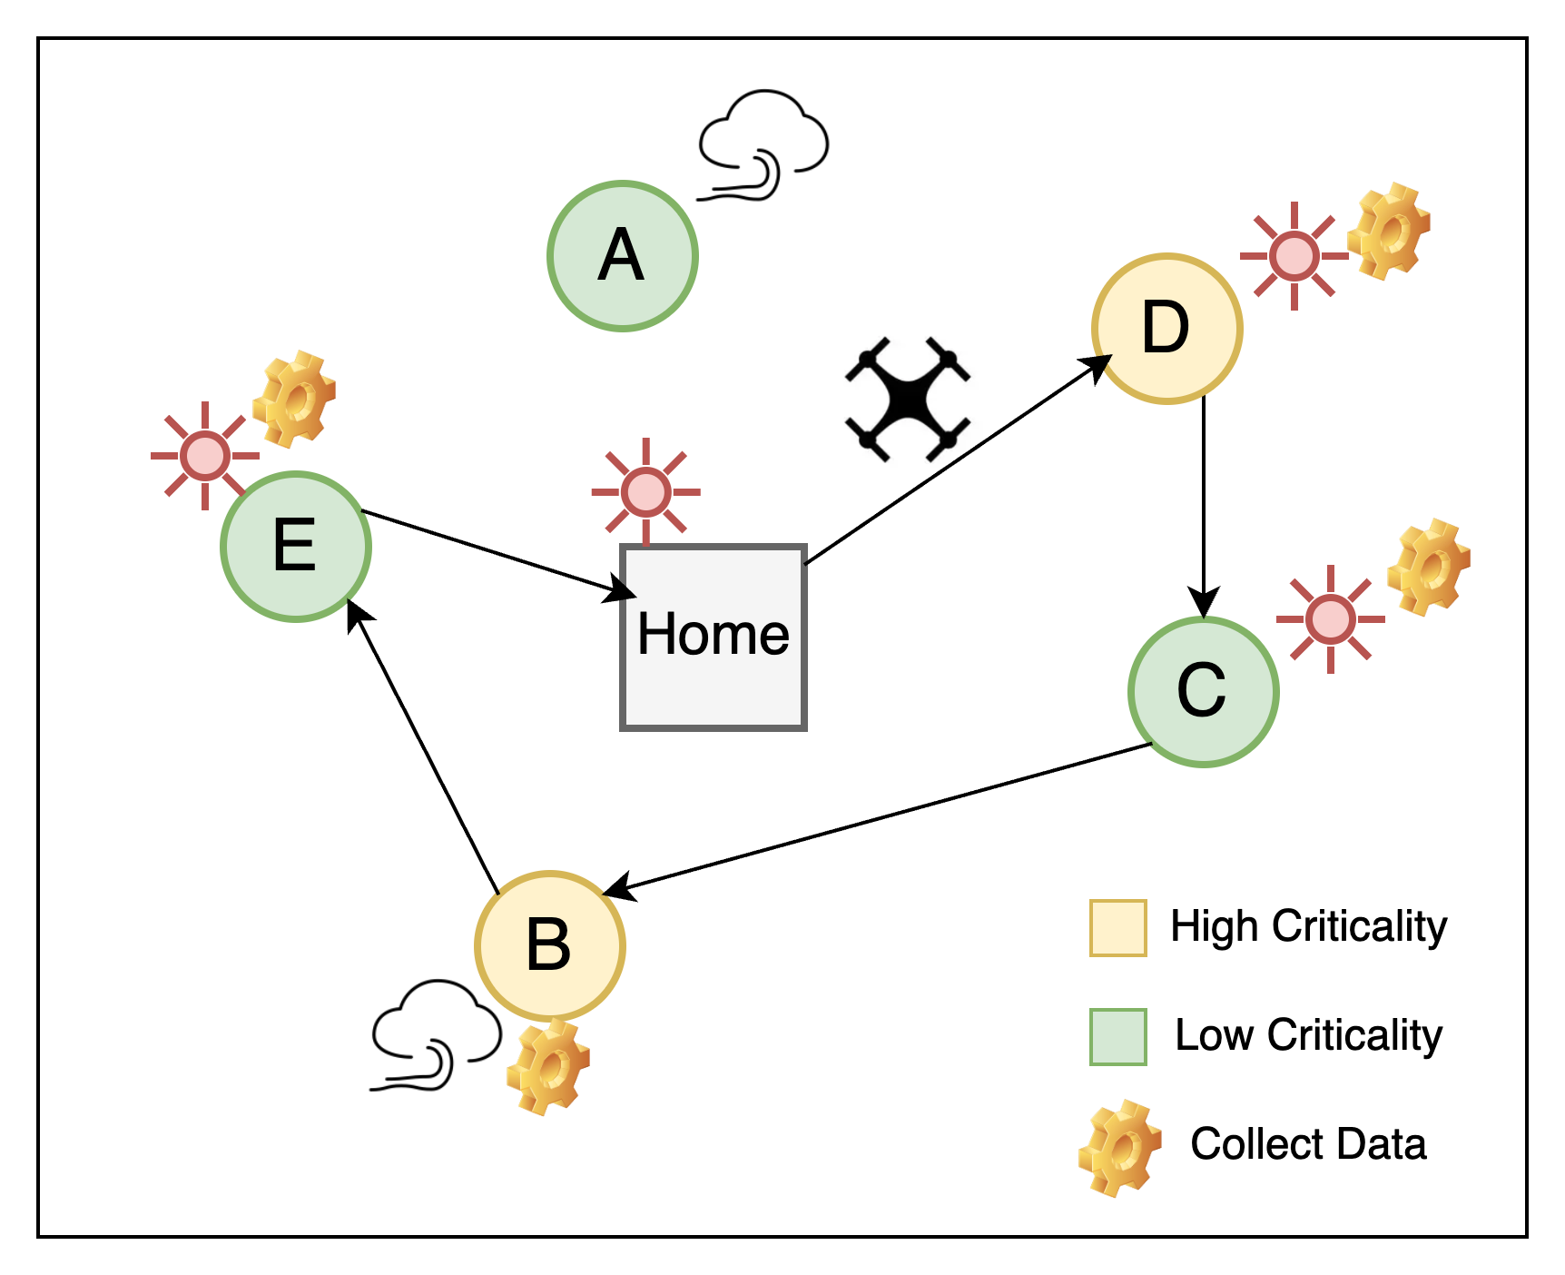
Problem Statement
We need to plan an optimal route for a drone to collect data from multiple locations, each with its own priority (e.g., high or low criticality) and specified time windows for data collection.
Key Objectives:
Route Optimization: Determine an optimal sequence of locations for the drone to visit, allowing it to skip certain locations based on mission priorities and constraints
Data Collection Time Allocation: Optimize the duration of data collection at each selected location
Notes:
Start and end at a designated home location
Visit a set of m locations, collecting data within specified time bounds
Allocate collection time efficiently, prioritizing high-value sites and adapting to changing weather conditions
Visit each location at most once
Return to home within a limited total flight time (T_max)
To address our key question, let's define the problem more concretely. Imagine a scenario where a drone is tasked with collecting data from multiple locations. Each location has its own priority level—for example, some might be highly critical, while others are less urgent—and a specific time window during which data collection must occur.
Our goal is to develop a plan that optimizes the drone’s route and data collection strategy. This involves two key objectives:
Route Optimization: We need to determine the best sequence of locations for the drone to visit. This includes making decisions about which locations to prioritize and, in some cases, which locations to skip altogether to align with mission priorities and constraints.
Data Collection Time Allocation: At each selected location, we must also decide how much time the drone should spend collecting data. Balancing the time spent at critical sites versus covering more ground is crucial to ensure mission success.
This image illustrates the scenario. The drone starts at a home base, visits various locations based on their criticality and time windows, and navigates environmental complexities like weather and resource limitations. By solving this problem, we can maximize the drone’s efficiency while ensuring the most valuable data is captured.

Slide 46
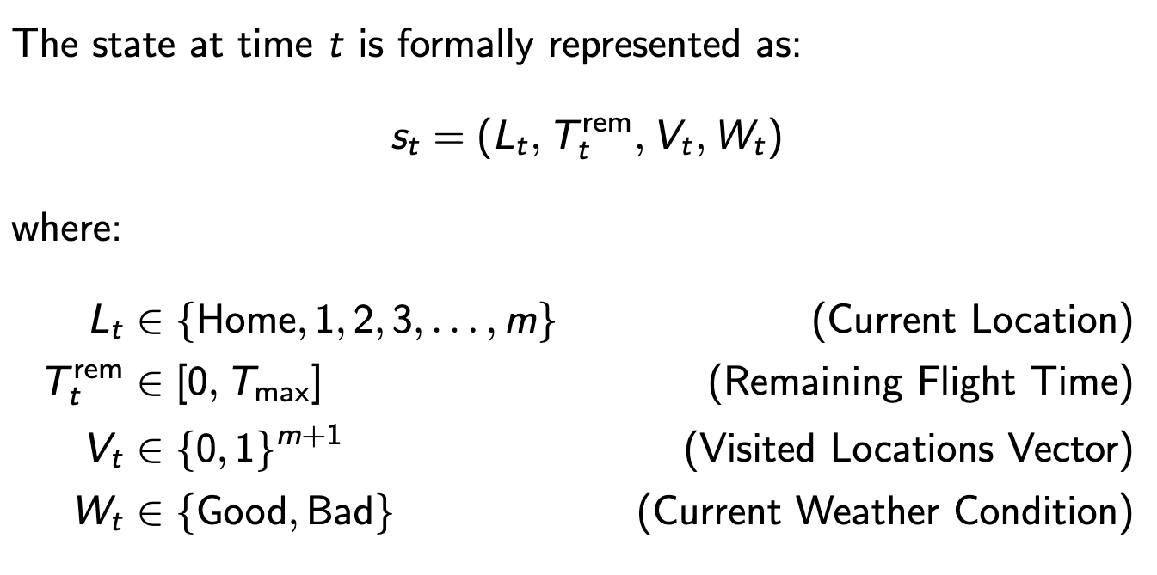
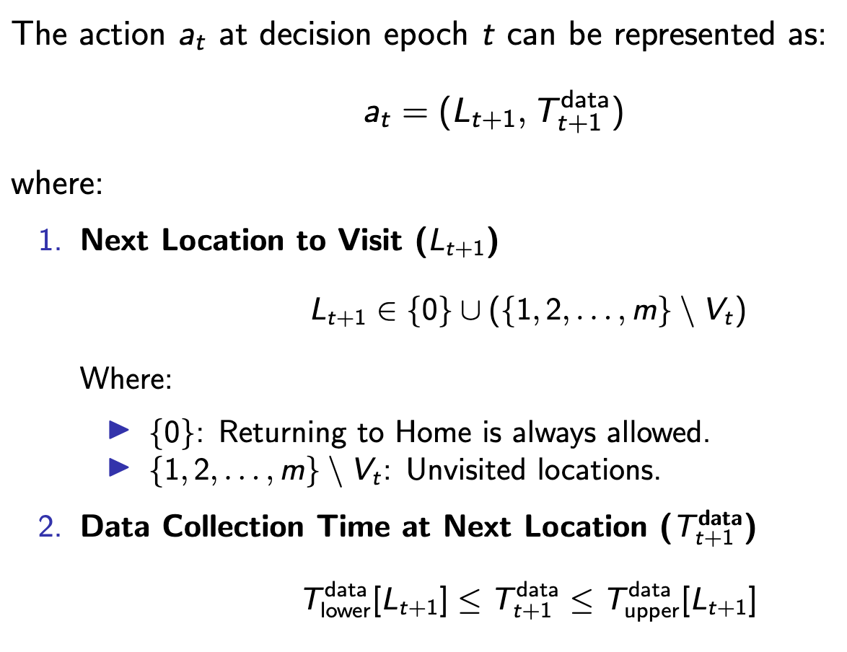
MDP Formulation
States
Actions
Notes:
Now that we understand the problem and its objectives, the next question is: how do we mathematically represent this problem to develop an optimal solution? To tackle the complexities of route optimization and data collection time allocation, we framed the problem as a Markov Decision Process.
Let me explain how we formulated our problem as an MDP. First, we defined the state space, which includes variables like:
The drone’s current location
The remaining flight time
The locations already visited
And even external factors, such as weather conditions.
Next, we defined the action space, which represents the decisions the drone can make at each step. This includes:
Choosing the next location to visit,
Determining the amount of time to spend collecting data at that location

Slide 47
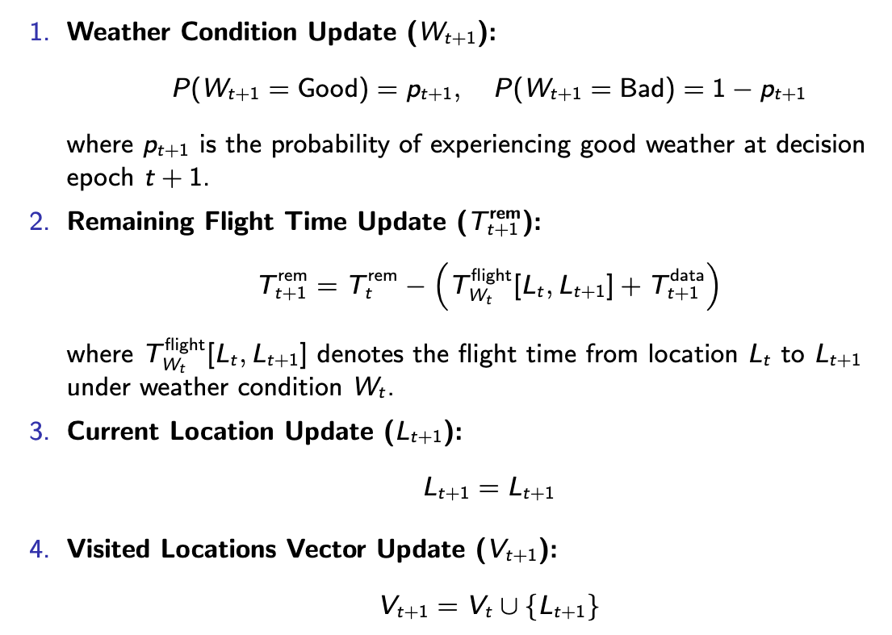
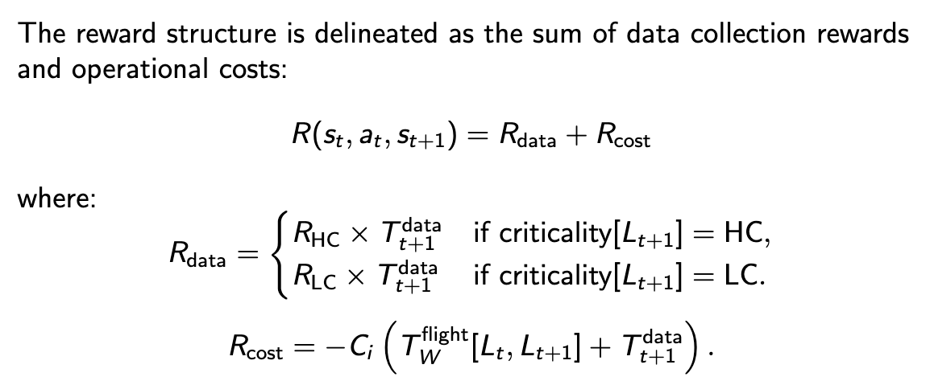
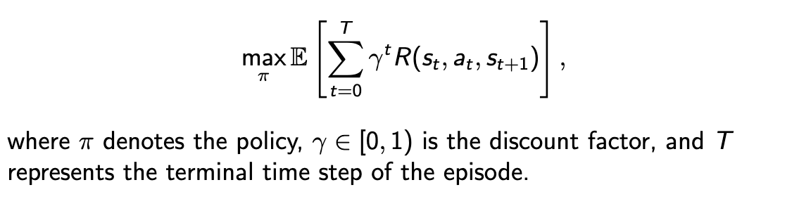
Objective & Reward
State Action Transition
Objective Function
Notes:
Now that we’ve framed the problem as an MDP with well-defined states and actions, the next step is to define how decisions are evaluated. In other words, we need to establish the objective and the reward system that guides the drone’s actions.
The state-action transitions in our MDP describe how the drone moves between locations, updates its remaining flight time, and adjusts the list of visited locations based on the actions taken. This allows the model to capture the consequences of every decision in real-time.
To guide these decisions, we defined a reward function that incentivizes the drone to:
Prioritize high-criticality locations,
Minimize unnecessary travel time or energy consumption,
And ensure data collection aligns with time-window constraints.

Slide 48
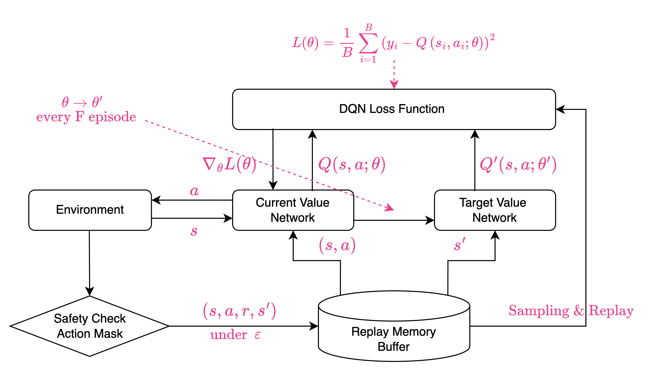
DQN-AM Model
Overview: We employ a Deep Q-Network with an Action Mask (DQN-AM) to efficiently learn an optimal policy under dynamic conditions.
Notes:
With the MDP formulation in place and the objective function clearly defined, the next challenge is solving the problem. Given the complexity of the state space and the dynamic nature of drone missions, traditional optimization methods struggle to handle these challenges efficiently.
To overcome this, we leverage Deep Reinforcement Learning, specifically a model based on Deep Q-Networks with Action masking, which we call DQN-AM. Let’s dive into how this model works and why it’s effective for solving our MDP problem.
Environment: Provides states, rewards, and transitions, simulating the drone’s route planning scenario.
Action Masking: Filters out invalid actions (e.g., already visited locations, insufficient flight time), ensuring the DQN only considers feasible decisions.
DQN Architecture:
Current Value Network: Estimates Q-values for each valid action.
Target Value Network: Stabilizes learning by providing a consistent baseline for Q-value updates.
Replay Memory Buffer: Stores past transitions (s,a,r,s′)(s,a,r,s')(s,a,r,s′) to enable efficient off-policy learning and decorrelate samples.

Slide 49
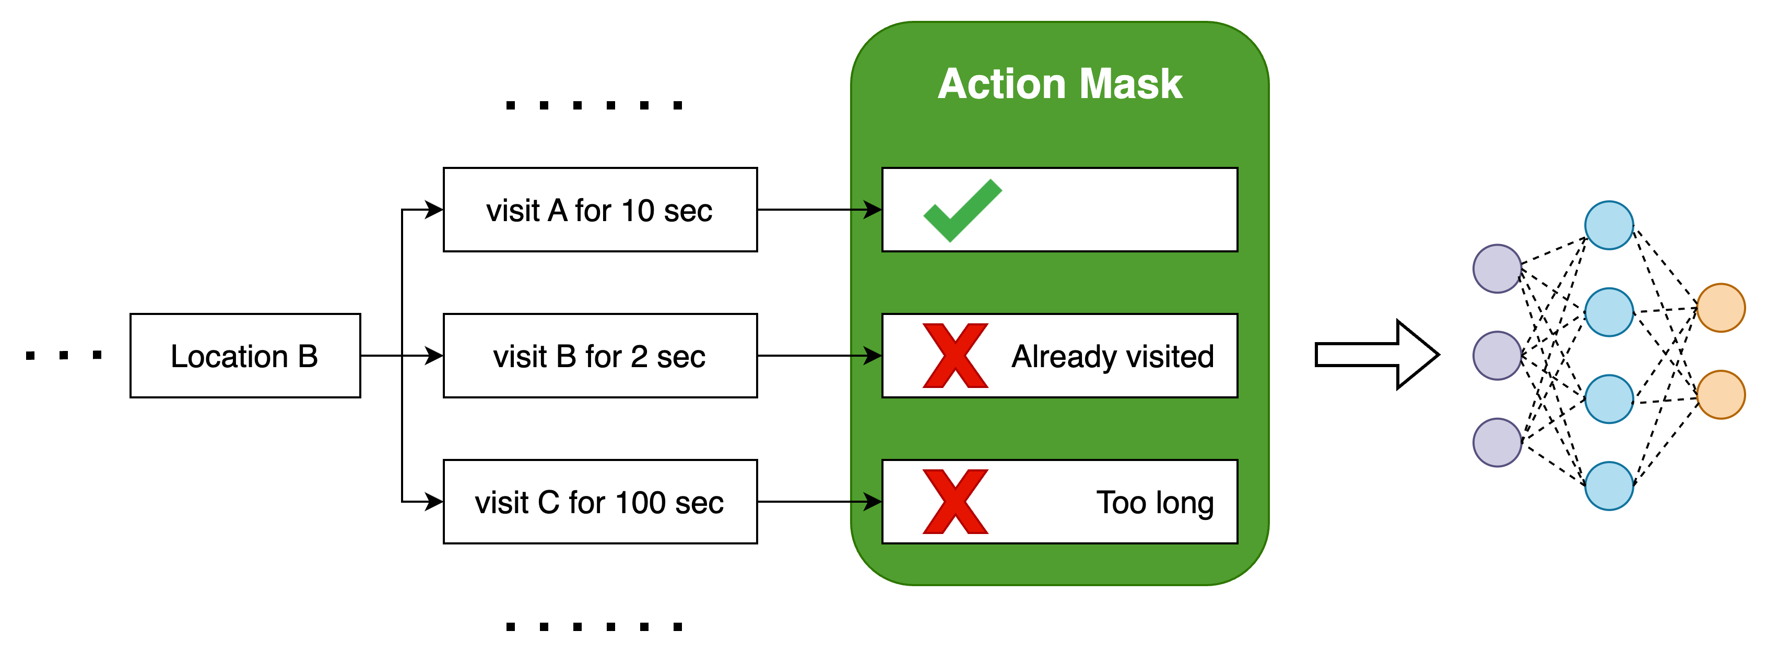
Action mask
Idea: When the drone decides its next move, not all actions are possible or logical. The “action mask” acts like a filter, ensuring the decision-making process only considers actions that meet certain criteria.
Key Checks:
Already Visited Locations
Invalid Data Collection Times
Insufficient Flight Time
By applying the action mask, our reinforcement learning agent (DQN) only sees a clean set of valid actions. This reduces wasted exploration and helps the model find better routes faster.

Slide 50
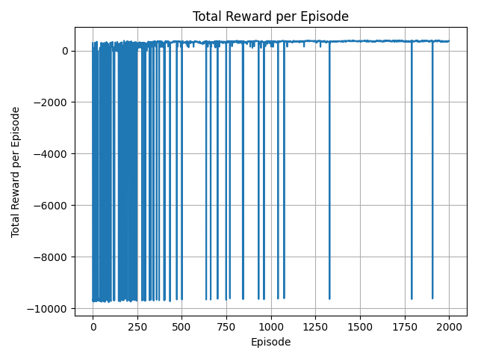
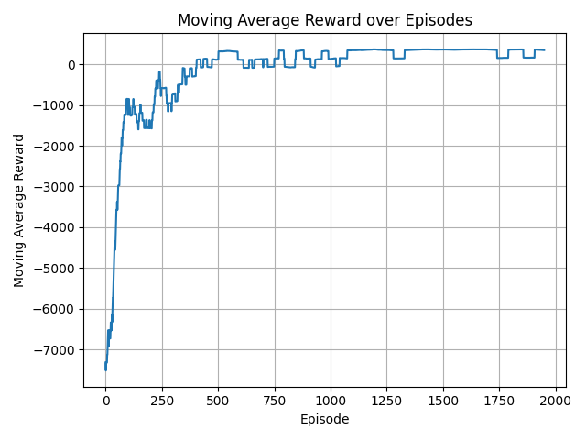
Training Performance Over Episodes
Total reward: The quality of the route chosen by the drone. Higher rewards reflect better data collection efficiency and adherence to constraints.
Picture 1
Picture 2
The Picture 1 shows total reward per episode, illustrating initial volatility as the agent explores.
The Picture 2 shows moving average reward smooths out variations, revealing a clear upward trend.
Key Takeaway: The policy converges to higher rewards, indicating improved decision-making for route planning.

Slide 51
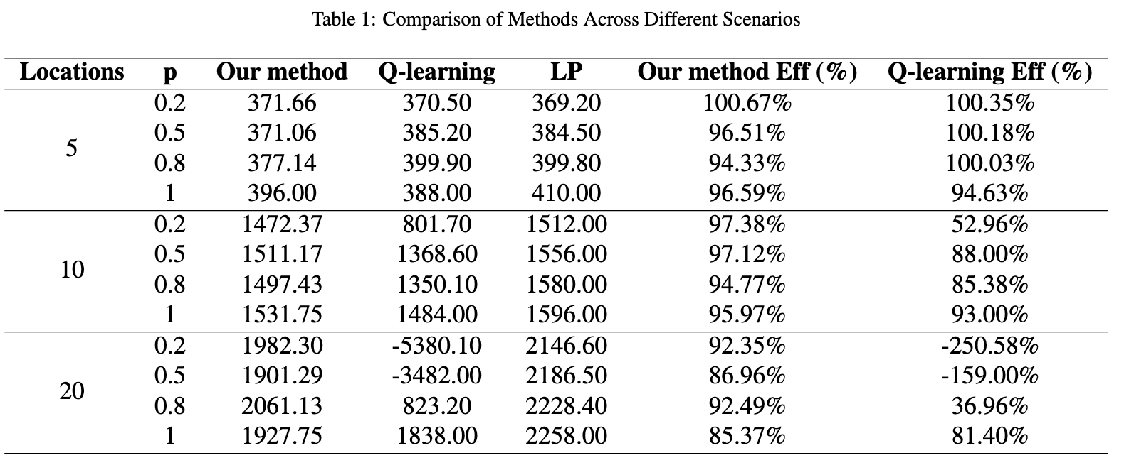
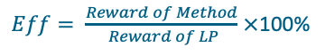
Comparative Experiments
Setup: We compare our RL-based approach to Q-learning and Linear Programming (LP) reward under varying numbers of locations and weather probabilities (p)
$Eff= \frac{Reward of Method}{ Reward of LP}$ $×$100%
Compared to LP:
LP can approximate optimal rewards in a fixed setting, but it cannot adapt to unpredictable weather.
Our RL method handles stochastic conditions, maintaining strong performance even as weather varies.
Compared to Q-learning:
Q-learning struggles as the number of locations grows, failing to find effective policies.
Our approach scales smoothly, remaining efficient and effective in large, complex scenarios.
Key Takeaway: Our method is both scalable and robust, achieving high efficiency and consistently performing well in uncertain, dynamic environments.

Slide 52
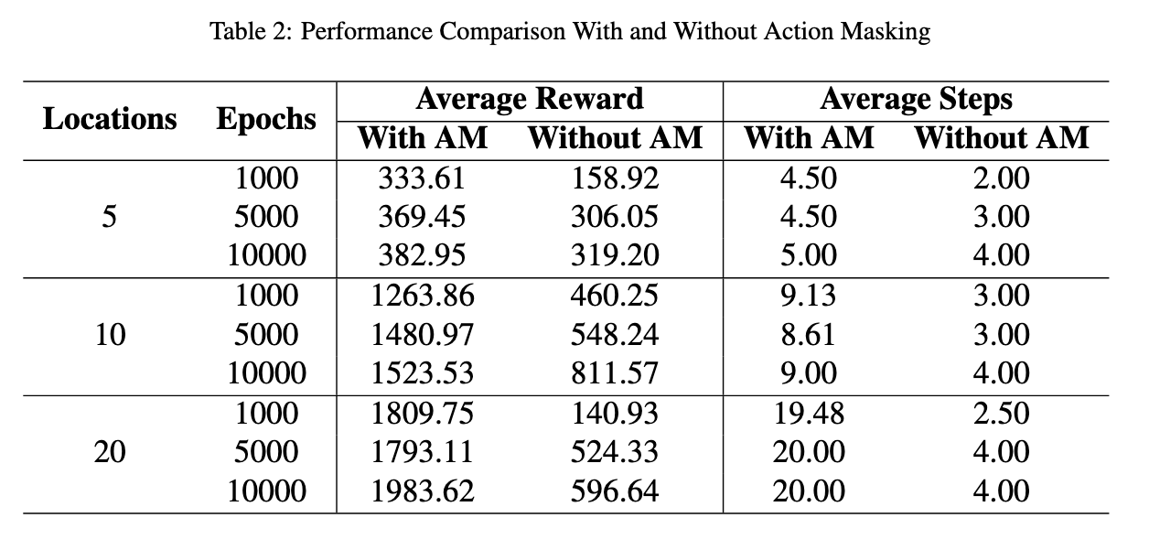
Ablation Study
With Action Masking (AM):
Reward: Significantly higher average rewards across all tested scenarios, indicating more effective policies.
Steps: Consistently more steps are taken, suggesting thorough exploration and the avoidance of premature episode termination.
Without Action Masking:
Reward: Lower average rewards, reflecting less efficient policy learning and suboptimal data collection.
Steps: Fewer steps, implying the agent often terminates earlier or chooses invalid actions that lead to suboptimal outcomes.
Key Takeaway:
Action masking filters out infeasible actions, guiding the agent towards better decisions. This leads to higher rewards, more consistent exploration, and overall improved performance in complex drone route planning tasks.

Slide 53
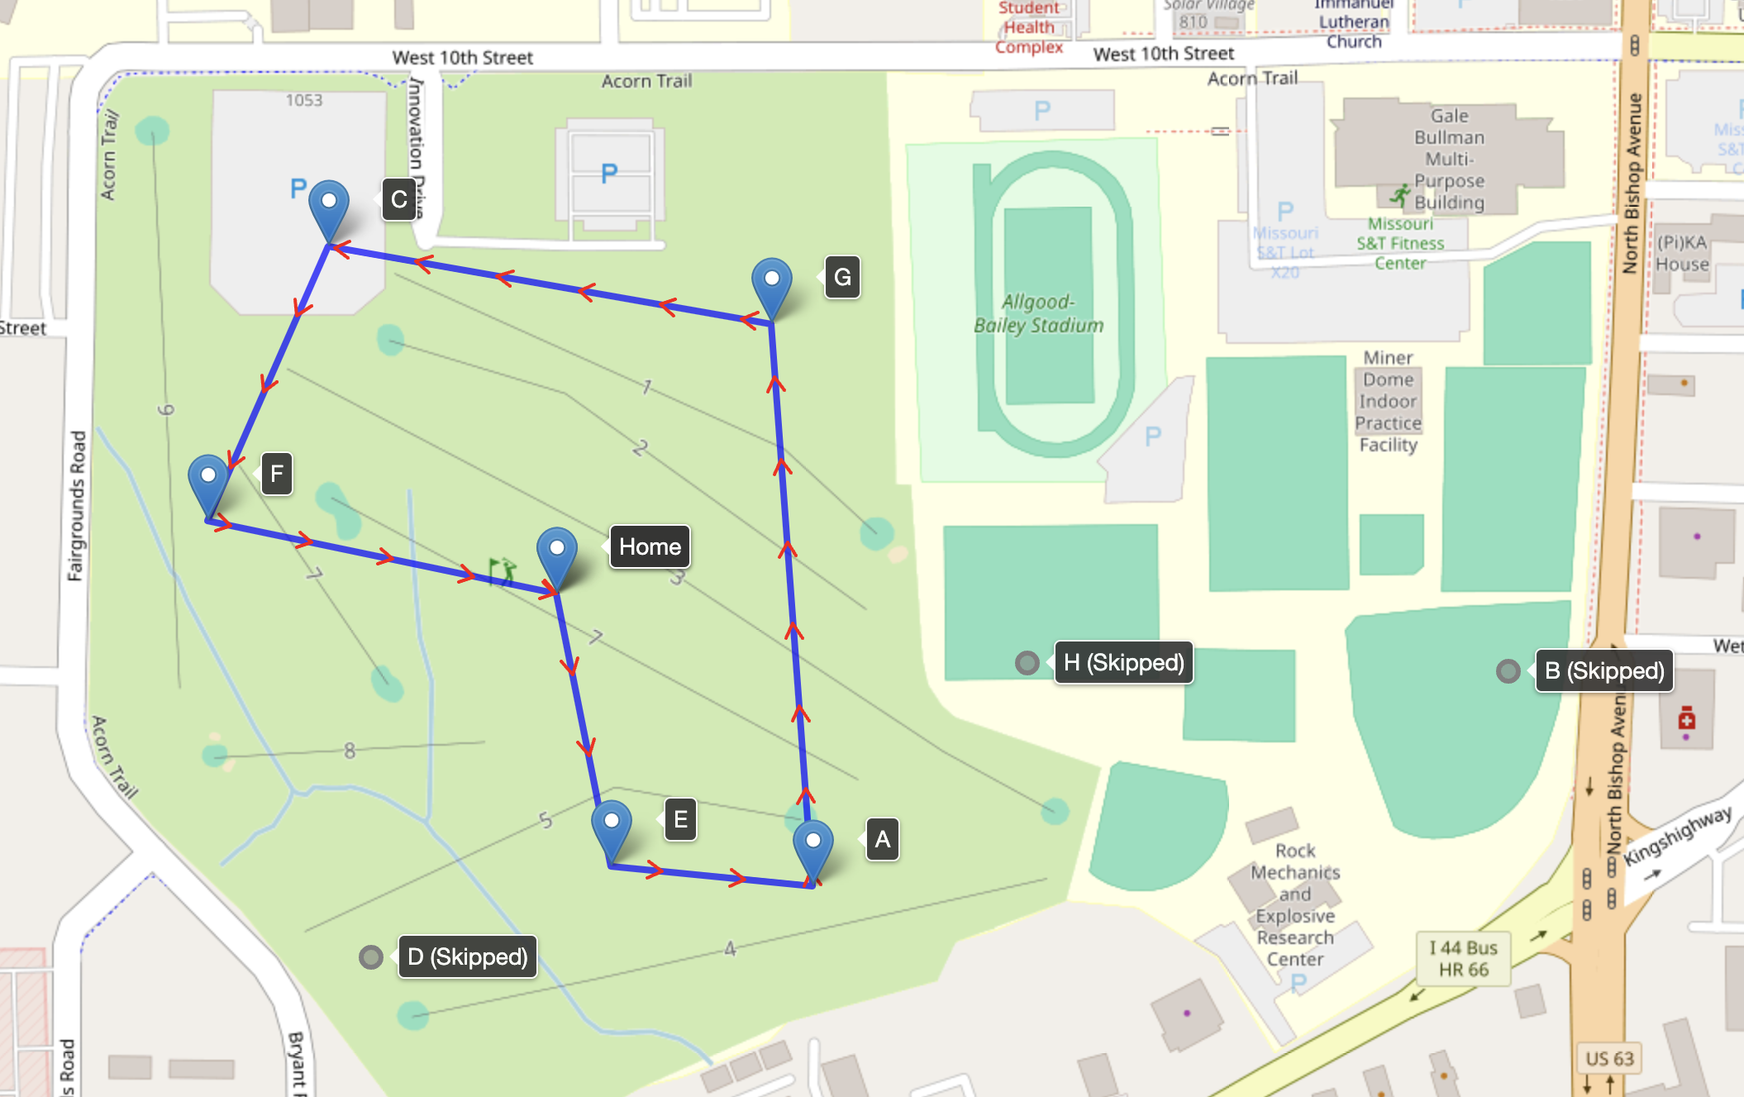
Real-World Data Experiments
Location | Data Collection Range (s) | Criticality
Home | / | /
A | 21–30 | LC
B | 15–25 | LC
C | 21–27 | HC
D | 21–30 | LC
E | 16–26 | HC
F | 18–24 | HC
G | 30–36 | HC
H | 12–20 | LC
Drone Aurelia-x4 Specifications[1]:
Flight Time: 40 Minutes
Flight Range: 5 km / 3 mi
Max. Flight Speed: 15 m/s
Max. Wind Resistance: 9 m/s
Battery nominal voltage: 22.2 V
[1] Website Link: https://aurelia-aerospace.com/product/aurelia-x4-standard/
[2] Demo Link: Real World Case with 8 Locations in MST
[3] Video Link: Real World Case with 8 locations in MST

Slide 54
Thank you
We appreciate your time and interest in our work.
Code Repository: https://github.com/JialiZhang1016/Drone
Demo Link: Real World Case with 8 Locations in MST
Video Link: Real World Case with 8 locations in MST

Slide 55
Project Output Summary
Category | Number | Main Items
Doctoral Dissertations | 2 | - Adversarial Transferability and Generalization in Robust Deep Learning - Lifelong Machine Learning with Adaptive Resonance Theory
Published Journal Papers | 4 | 4 papers
Conference Papers | 5 | 5 papers
Under Review Papers | 3 | Lifelong Context Recognition via Online Deep Feature Clustering. Optimizing Drone Routes with Deep Reinforcement Learning Feature Map Rearrangement: A Zero-Flop Method for Enhancing Adversarial Transferability Efficiently.
Procurement of Equipment | 2 | - FLIR Hadron 640R Thermal Cameras - Aurelia X4 UAV

Slide 56
Project Output Summary
Category | Number | Main Items
Software/Code Repositories | 5 | - Adaptive Resonance Theory Algorithms - Cluster Validity Indices - Meta-iCVI - Drone Route Planning with Reinforcement Learning - Code for Published Papers
Demos | 3 | - Super-Resolution using Transformers - Real-Time Object Recognition using YOLO - UAV Data Collection Path Planning using Deep RL
Technical Presentations | 4 | - Teledyne-FLIR Collaboration Presentations - Thermal Images Super-Resolution Challenge at PBVS Workshop on CVPR 2024 - YOLO for Real-Time Object Detection - Lifelong Context Recognition via Online Deep Clustering

Slide 57
Doctoral Dissertations
1. Adversarial Transferability and Generalization in Robust Deep Learning
Author: Tao Wu
Advisor: Dr. Donald C. Wunsch II, Co-Advisor: Dr. Tie Luo
Defense Date: June 11, 2024
https://calendar.mst.edu/event/final-doctoral-defense-for-tao-wu
2. Lifelong Machine Learning with Adaptive Resonance Theory
Author: Sasha Petrenko
Advisor: Dr. Donald C. Wunsch II
Defense Date: November 13, 2024
https://calendar.mst.edu/event/final-doctoral-defense-for-sasha-petrenko

Slide 58
Journal Papers
Leonardo Enzo Brito da Silva, Nagasharath Rayapati, and Donald C. Wunsch. Incremental Cluster Validity Index-Guided Online Learning for Performance and Robustness to Presentation Order. IEEE Transactions on Neural Networks and Learning Systems, Volume 34, Issue 10, 2023, Pages 6686-6700.
Raghu Yelugam, Leonardo Enzo Brito da Silva, and Donald C. Wunsch. Topological Biclustering ARTMAP for Identifying Within Bicluster Relationships. Neural Networks, Volume 160, 2023, Pages 34-49.
Niklas Melton, Sasha Petrenko, and Donald C. Wunsch. Meta-iCVIs: Ensemble Validity Metrics for Concise Labeling of Correct, Under-, or Over-Partitioning in Streaming Clustering. IEEE Access, Volume 12, 2023, Pages 11114-11124.
Sasha Petrenko, Daniel B. Hier, Mary A. Bone, Tayo Obafemi-Ajayi, Erik J. Timpson, and Donald C. Wunsch. Analyzing Biomedical Datasets with Symbolic Tree Adaptive Resonance Theory. Information, Volume 15, Issue 3, 2024, Page 125.

Slide 59
Conference Papers
Tao Wu, Tie Luo, and Donald C. Wunsch. GNP Attack: Transferable Adversarial Examples via Gradient Norm Penalty. Proceedings of the IEEE International Conference on Image Processing (ICIP), 2023, Pages 3110-3114.
Tao Wu, Tie Luo, and Donald C. Wunsch. CR-SAM: Curvature Regularized Sharpness-Aware Minimization. AAAI Conference on Artificial Intelligence (AAAI), 2024.
Tao Wu, Tie Luo, and Donald C. Wunsch. LRS: Enhancing Adversarial Transferability through Lipschitz Regularized Surrogate. AAAI Conference on Artificial Intelligence (AAAI), 2024.
Jian Liu, Iwan Sandjaja, and Donald C. Wunsch. AI Trustworthy: A Survey of Ethical, Sociological, and Technological Dimensions. 18th IEEE International Conference on Service Operations and Logistics, and Informatics (SOLI), 2024.
Iwan Sandjaja, Ahmad Alsharoa, Donald C. Wunsch, and Jian Liu. Survey of Hidden Markov Models (HMMs) for Sign Language Recognition (SLR). 7th IEEE International Conference on Industrial Cyber-Physical Systems (ICPS), 2024.

Slide 60
Under Review
Sasha Petrenko, Andrew Brna, Mario Aguilar-Simon, and Donald C. Wunsch. Lifelong Context Recognition via Online Deep Feature Clustering. Submitted to Neural Networks; Preprint available at IEEE TechRxiv.
Jiali Zhang, Yuwei Long, Donald C. Wunsch II, and Jian Liu. Optimizing Drone Routes with Deep Reinforcement Learning: A Stochastic Approach.
Tao Wu, Tie Luo, and Donald C. Wunsch. Feature Map Rearrangement: A Zero-Flop Method for Enhancing Adversarial Transferability Efficiently. Submitted to International Joint Conference on Artificial Intelligence (IJCAI), under review, 2024.

Slide 61
Software/Code Repositories
Adaptive Resonance Theory Algorithms
Julia: https://github.com/AP6YC/AdaptiveResonance.jl
Python: https://github.com/NiklasMelton/AdaptiveResonanceLib
Cluster Validity Indices
Julia: https://github.com/AP6YC/ClusterValidityIndices.jl
Python: https://github.com/AP6YC/cvi
JOSS Paper: https://joss.theoj.org/papers/10.21105/joss.03527
Meta-iCVI
Julia: https://github.com/AP6YC/MetaICVI.jl
Python: https://github.com/AP6YC/metaicvi
Drone Route Planning with Reinforcement Learning
Repository: https://github.com/JialiZhang1016/Drone

Slide 62

Business Status Report

Slide 63
Business Status Report
Income Statement (Project Duration: 09/01/22-11/13/24)
Total Expenses: $483,459.80
(Includes direct and indirect costs)
Total Direct Costs: $330,688.01
Salaries & Wages: $192,885.95
Staff Benefits: $41,468.37
Department Operating Expenses: $11,038.27
Student Aid: $38,247.52
Subcontracts: $25,000.00
Subcontracts > $25,000: $22,047.90
Total Indirect Costs: $152,771.79

Slide 64
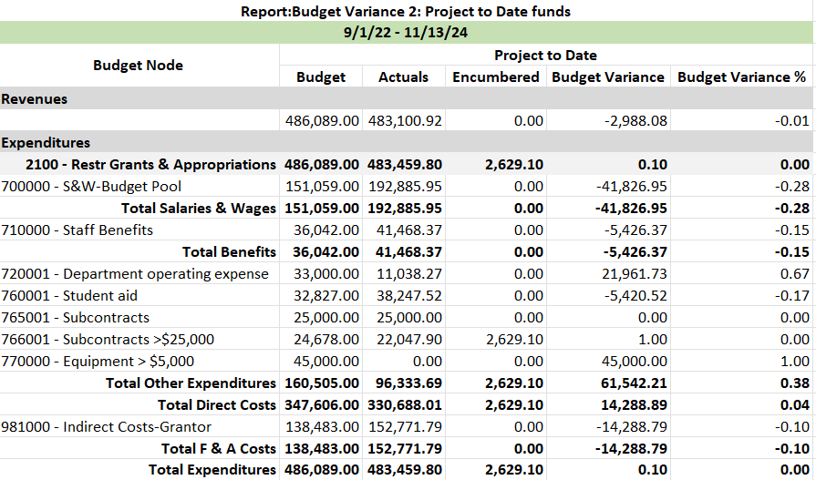
Business Status Report

Slide 65

Conclusion

